Slide 1
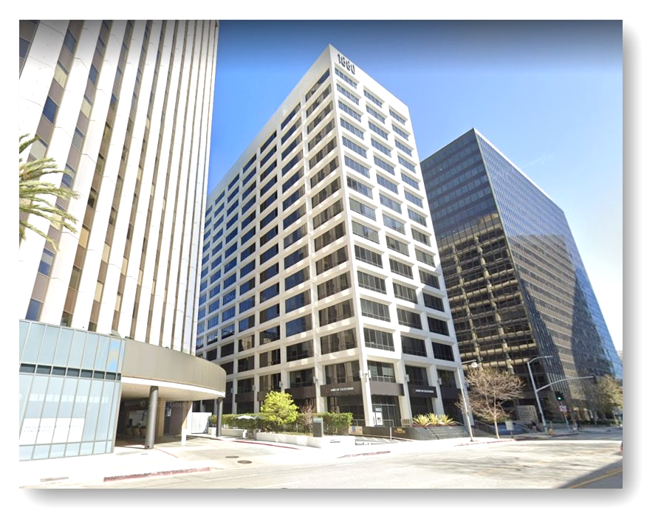


Agenda: LinkedIn Live – Navigating Eaton Fire Insurance Claims
📅 Date & Time: February 5th, 2025 | 6:00 PM PST
Timothy D. McGonigle, Esq./Thomas Foote
TIMOTHY D. MCGONIGLE, APC
1880 Century Park East, Suite 516
Los Angeles, CA 90067
Telephone (800) 713-5260
Website: mcgoniglelaw.com

Slide 2
Agenda
Obtaining a Copy of the Policy
Primary Dwelling Coverage
Relocation/Rebuilding
Rebuilding/Xactimate
Personal Property Coverage
California Fair Plan
Key Points
Deadlines to Bring Claims
Claims Against Third Parties
2

Slide 3
Obtaining a Copy of the Policy
Obtain a complete copy of the policy
Most insureds that suffer loss of home/evacuation orders will not have the policy. Make sure that your policy contains all endorsements (normally at the back of the policy)
File the claim with the insurance company as well as the agent and let the insurance company know right away the extent of the insured’s damages.

Slide 4
Primary Dwelling Coverage
Primary dwelling coverages is generally replacement cost (replacement of home at today’s prices) or actual cash value (cost of replacement less depreciation in value from the date the home was purchased)
Dwelling coverage covers the physical structure of the home.
Extended Dwelling coverage is an additional amount of coverage in the event the insured’s home costs more to build than what the insured’s dwelling coverage provided for: typically, will be a percentage of the insured’s dwelling coverage.
Other structure coverage: This is separate from the dwelling coverage and is usually 10% of the dwelling coverage; covers carport, shed, barn, and pool.
4

Slide 5

Relocation/
Rebuilding
California Insurance Code 2051.5 (c) provides for the right to rebuild or relocate after a total loss.
Many carriers will pay for the entire relocation coverage upfront if the house is destroyed. Others may require documentation.
5

Slide 6
Rebuilding/
Xactimate
Many carriers use Xactimate software to estimate the cost to repair or rebuild homes
Carrier’s settlement offer based on Xactimate estimates.
Crucial to have a public adjuster or contractor that is intimately familiar with Xactimate and actual costs of building materials, equipment and labor pricing and can challenge the insurance company’s calculations

Slide 7

Problems with Xactimate
  Was developed for tract houses; not custom homes and use generic pricing.
  Studies have found that Xactimate does not accurately reflect increases in costs of building materials, labor and materials, resulting in a significant underpayment to homeowners.

Slide 8
Problems with Xactimate cont.
  Xactimate does not warrant the accuracy of Price Data as it specifically states that it is intended to be a representation of historical information to be used as a baseline for creating an estimate.
  With the number of homes destroyed or damaged, market conditions will most likely increase prices of material costs and labor.
  User bias – Xactimate estimates can be pushed in the insurer’s favor by how data is input by the adjuster and how the output is interpreted.

Slide 9
Personal Property
Personal property coverage is for the contents of the home; often, will be 50% of the dwelling coverage.
Provide a detailed list of personal property. Photographs and receipts are helpful.
If a total loss, refer to department store registries to help prepare a list of personal property lost.
Many policies have limits for jewelry, furs, computer equipment, and business property.
Some carriers are making upfront payments of half the covered amount – ask if they will do this for you to help client’s cash flow.

Slide 10
Ordinance/Code Upgrades; usually 10% of the dwelling coverage.
This covers the cost of upgrading the structure to meet current code requirements. Normally, for older houses, the cost of code upgrades may exceed 10%.

Slide 11
Alternative Living Expense Coverage
Is a primary dwelling coverages available to homeowners cont.
Covers the cost of temporary housing, meals, storage of personal items, and other necessary housing expenses while the insured is rebuilding/repairing.
  Insurance company is required to advance four months of ALE per Insurance Code 2060.
  Typically is available for three years.
  If ALE is a set dollar amount, insured should stretch that money as long as possible. If the insurance policy provides a total dollar limit for ALE, best to look at more affordable housing so insured is not caught short if there are delays.
11

Slide 12
Other Primary dwelling coverages available to homeowners cont.
Debris Removal: Normally 5% of the Dwelling Coverage for cleaning up the property.
  Photos of the debris are helpful
  Written estimates from debris removal company
  LA County is offering “free” debris removal. If you participate in the 2025 Los Angeles Wildfires Debris Removal Program, you are required to assign any specific debris removal insurance proceeds to the County. In many cases, the debris removal limits are an additional 5% over the dwelling limits. However, if debris removal is not on top of, but is included in your structure limits, the Insurance Commissioner has issued guidance that payment to the County for debris removal under those circumstances “shall be limited to the unused benefit amount (if any) after the residence is rebuilt, subject to the reasonableness standard mentioned above.”
12

Slide 13
Other Primary dwelling coverages available to homeowners cont.
Shrubs and Replanting: Normally 5% of the Dwelling Coverage for replacing landscaping.
  Photos and estimate from Garden Supply will substantiate loss
  Landscape professional can be of assistance
13

Slide 14

California Fair Plan
These are policies written in wildfire areas which are designed to be the option of last resort if you can’t get conventional coverage. The Fair Plan offers maximum of $3 million coverage for dwelling coverage.
Basic fire insurance coverage damage caused directly by fire, as well as smoke, heat, and water damage resulting from firefighting efforts.
May not cover replacement cost coverage; only actual case value which means depreciation is deducted. Check the policy.

Slide 15
California Fair Plan
X
The CA Fair Plan MAY not cover the following perils (check your policy):
Personal Property.
Additional Living Expenses (living expenses when displaced by a fire).
Cost of code upgrades

Slide 16
Key Points
Key Points when dealing with the insurance carrier:
Keep the insurance carrier, agent and mortgage lender informed from the claim filing through the rebuilding process.
Have a detailed discussions of how the rebuilding process will be paid so there are no surprises.
Keep the communications friendly.
Document all communications by email.
Challenge the Xactimate calculations and resolve them.
16

Slide 17
Key Points cont.
6. Don’t let carrier try to limit the ALE.
7. DO accept advance payments from the carrier, but not for full settlement
8. Some carriers will look for irregularities in the application and may try to rescind the policy.
9. Insurance code Section 790.03 sets forth unfair claims practices
10. Insurers owe their insured a duty to treat them in good faith – which basically means to act reasonably, and if they fail to do so, may be liable for punitive damages in a lawsuit based on bad faith.
17

Slide 18
Deadlines to Bring Claims
General insurance policies require that lawsuit be brought within one year of the proof of loss being provided.
Time period is tolled while the insurance company investigates the claim and starts to run when carrier send out a denial.
Department of Insurance extends the one-year deadline for natural disasters to two years.
18

Slide 19
Claims against Third Parties
Claims against third parties responsible for wildfires will permit the homeowner to recover additional damages that were not paid by insurance:
Relocation costs in the event ALE is exhausted
Costs to the homeowner for cost or rebuilding that are not covered by insurance or when the home is underinsured and unreimbursed contents
Personal injury claims and emotional distress damages
Loss of income or business profits
Loss of personal property if not covered
Inverse condemnation claims

Slide 20
Timothy D. McGonigle, Esq./Thomas Foote
TIMOTHY D. MCGONIGLE, APC
1880 Century Park East, Suite 516
Los Angeles, CA 90067
Telephone (800) 713-5260
Website: mcgoniglelaw.com

